Slide 1
STORYTELLING CASE STUDY: AIRBNB, NYC PRESENTATION - II
BY
RAGUL | POOJA KUMARI | NEELANJAN ROY

Slide 2
OBJECTIVE
Identify and prioritize high-value hosts based on factors like property type, location etc.,
Optimize property offerings in key areas based on neighborhoods, property types, and pricing ranges.
Provide early recommendations to leaders of Airbnb in order to help them make business decisions.

Slide 3
BACKGROUND
For the past few months, Airbnb has seen a major decline in revenue.
Now that the restrictions have started lifting and people have started to travel more, Airbnb wants to make sure that it is fully prepared for this change.
To prepare for the next best steps that Airbnb needs to take as a business, analysis of dataset consisting of various Airbnb listings in New York has to be done.

Slide 4
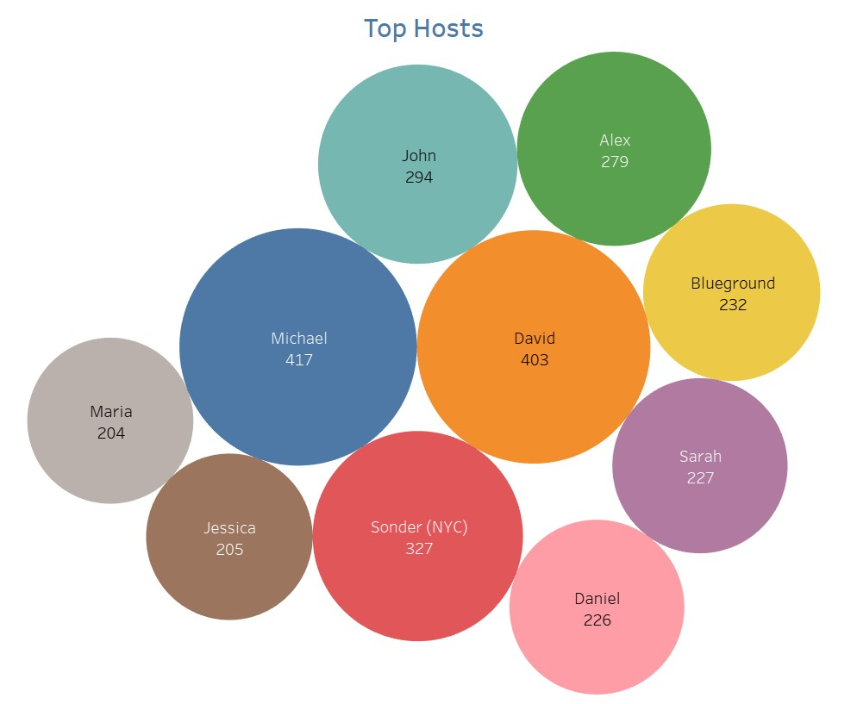
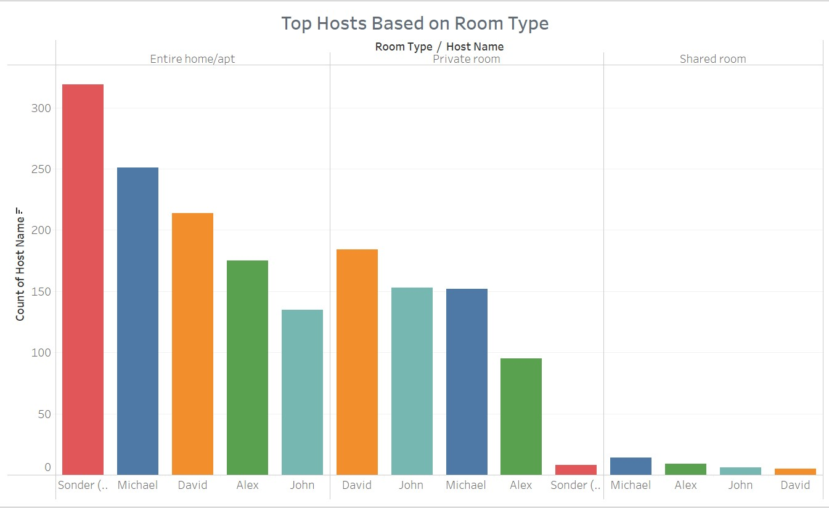
TOP HOSTS BASED ON ROOM TYPE
Michael is the top host based on the overall bookings of 417.
Based on the room type, Sonder(NYC) leads in Entire home/apt category with 319 bookings and David leads in Private room category with 184 bookings.
Sonder(NYC) has highest number of bookings in the Manhattan neighbourhood group and Michel has highest bookings in the Brooklyn.

Slide 5
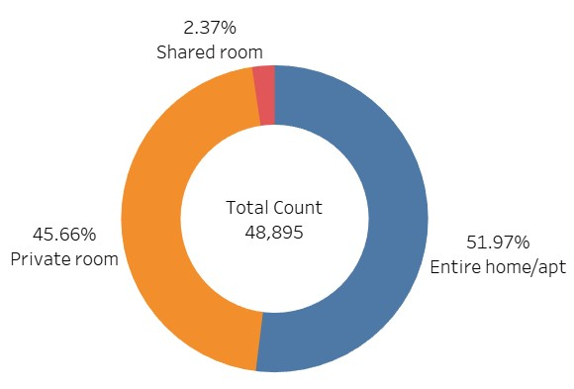
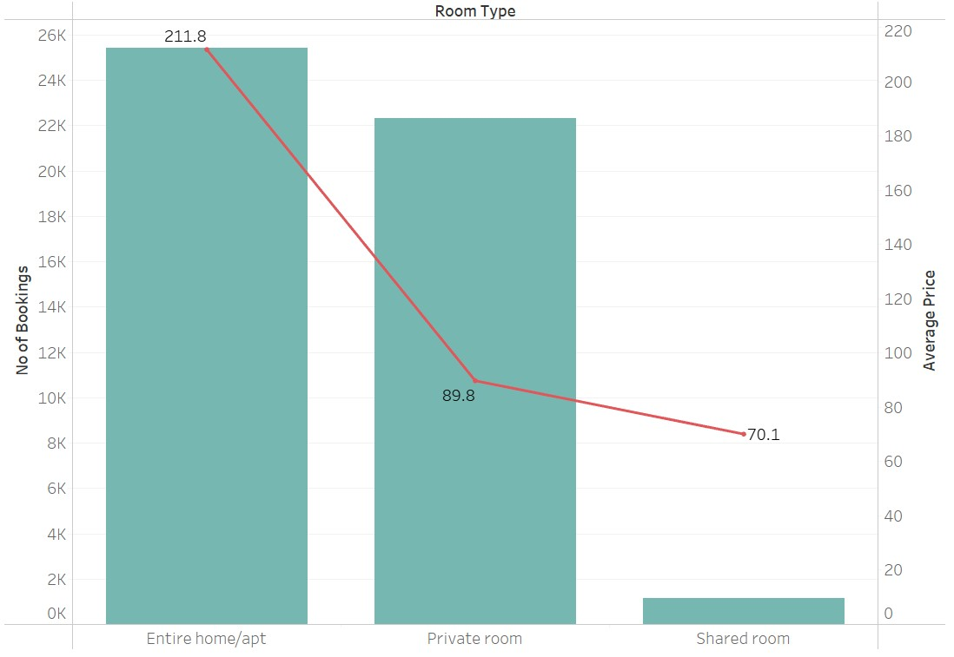
BOOKINGS BASED ON ROOM TYPE
Among the room types, “Entire home/apt” shares 51.97% of total bookings and average price of bookings stands at 211.8 USD.
In-spite of average price of Shared room being lowest (70.1) among the other room types, total share of bookings stands at 2.37%
Private rooms have optimum average price of 89.8 USD and has good share of bookings standing at 45.66%

Slide 6
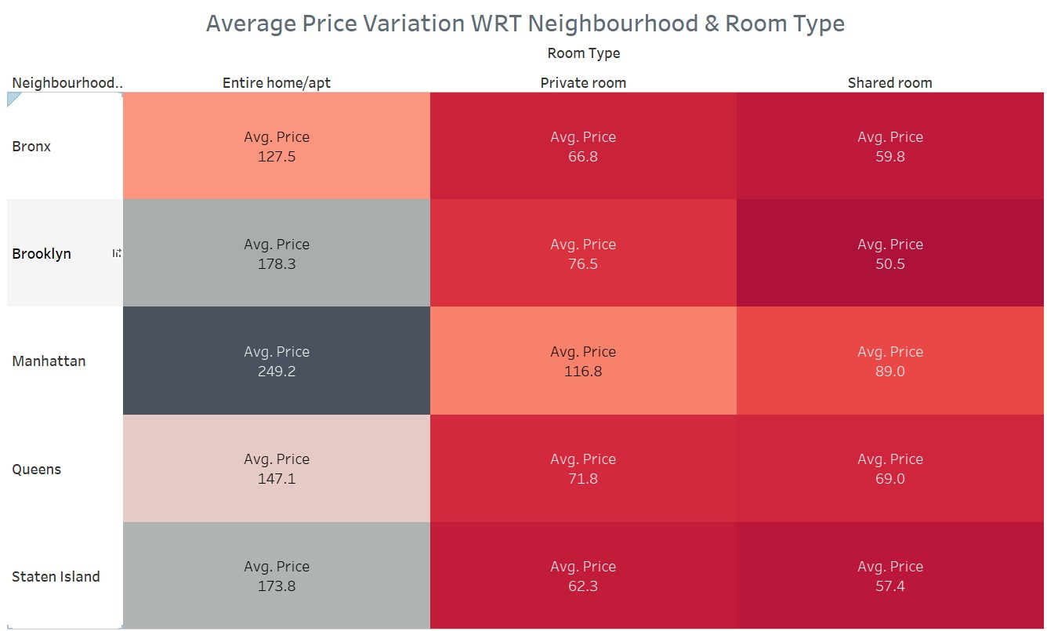
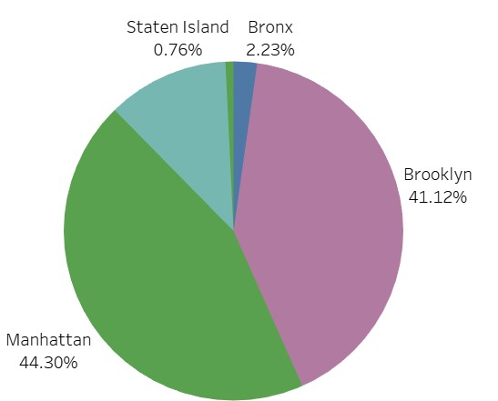
PRICE BASED ON NEIGHBOURHOOD GROUP
Among the neighbourhood group, Manhattan holds the highest share of booking with 44.30% of total bookings.
Entire home/apt types of room in Manhattan is as expensive as 249.2 USD whereas Brooklyn having share of 41.12% of total bookings has average price of 178.3 USD
Shared room has lowest average price among all neighbourhood groups with Brooklyn having average price of 50.5 USD for shared rooms.

Slide 7
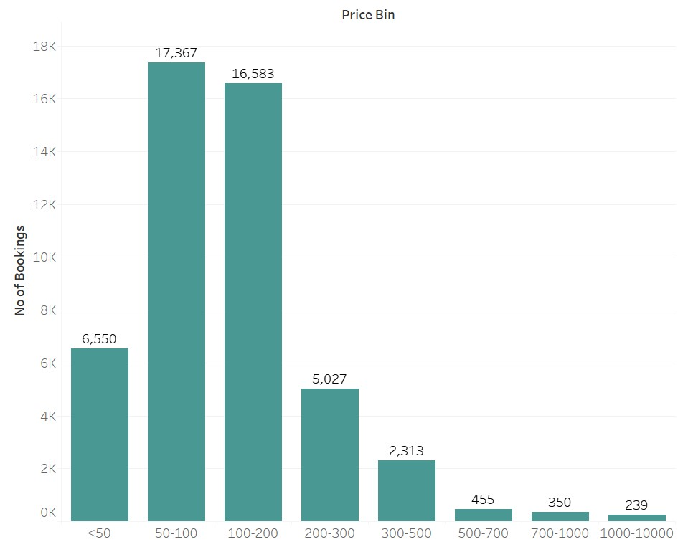
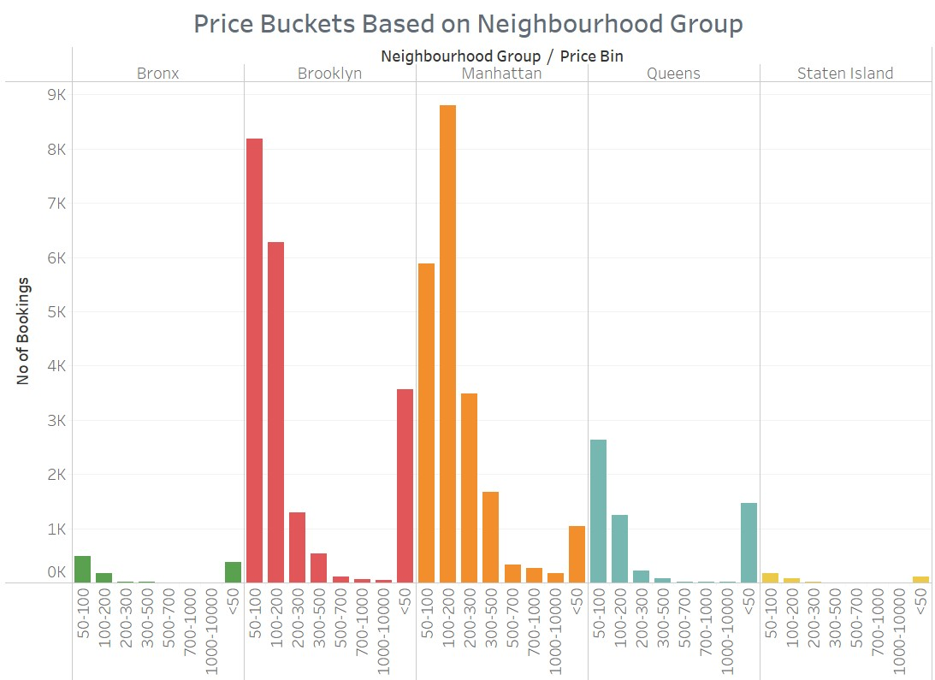
FOCUSING ON 50 – 200 USD ROOMS FOR HIGHER REVENUE
Customers are preferring listings based on the price range of 50 to 200 USD which holds 33950 bookings.
Among the neighbourhood group of Manhattan, 8803 bookings belong to price range of 100 – 200 USD and Brooklyn has 8190 bookings belonging to 50 to 100 USD range.
Brooklyn has highest bookings among listing’s price lesser than 50 USD standing at 3572 bookings.

Slide 8
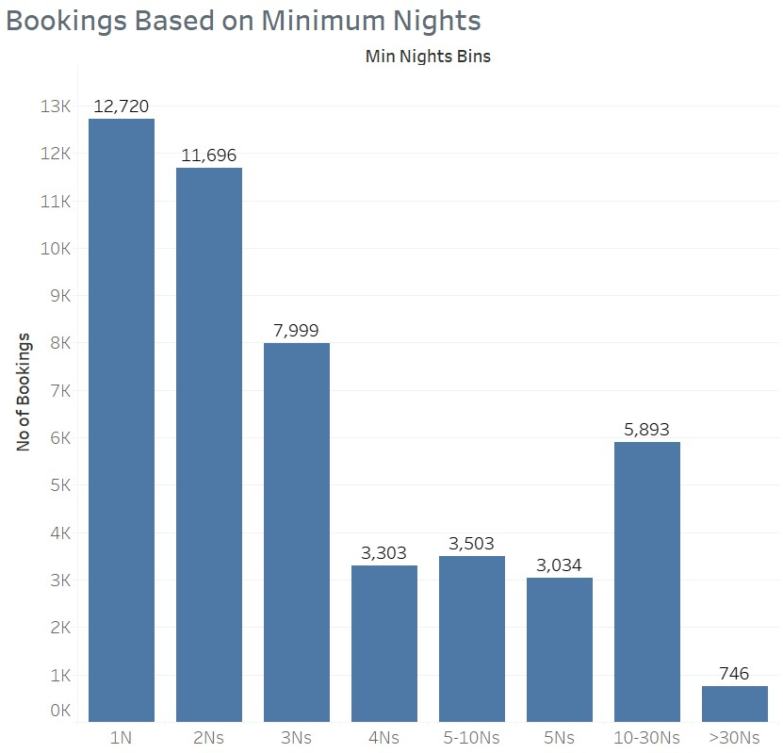
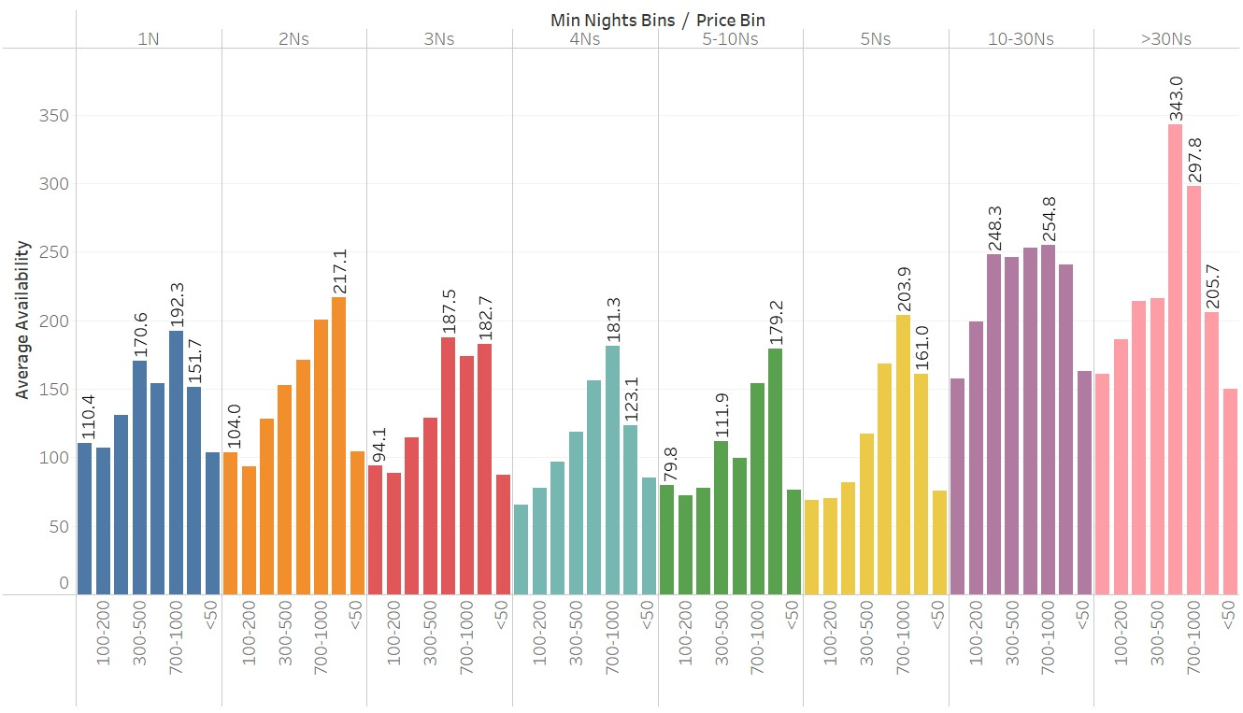
AVAILABILITY OF MINIMUM ONE NIGHT LISTINGS NEEDED TO BE INCREASED
Among the listings with minimum night of one day has highest bookings with total of 12720.
With respect to availability, listings with minimum nights of 10 to 30 days has highest average availability of 192 days.
In-spite of minimum night of 1 day has highest bookings, average availability of bookings is as low as 113 days.

Slide 9
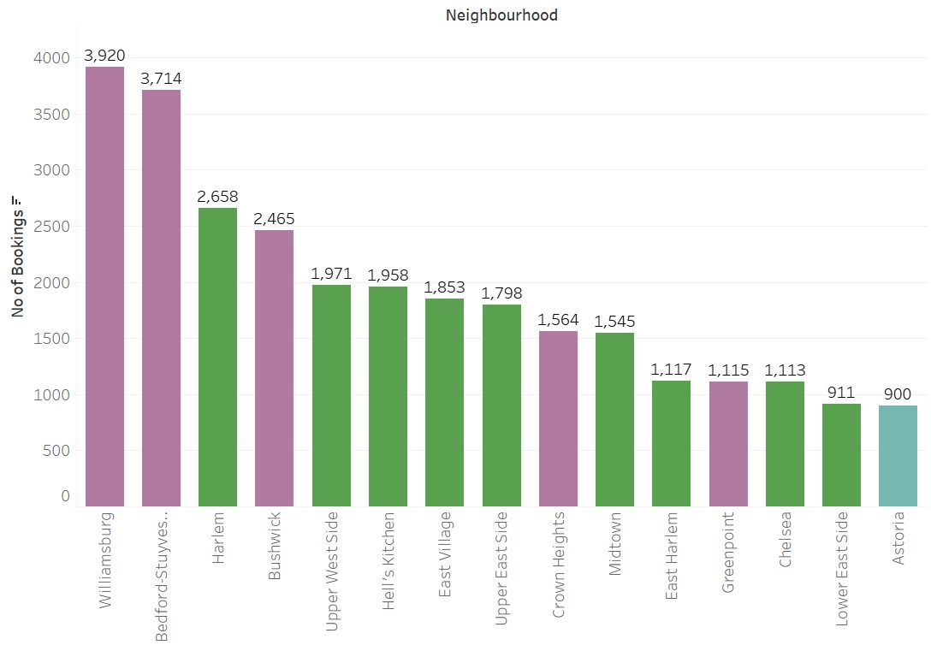
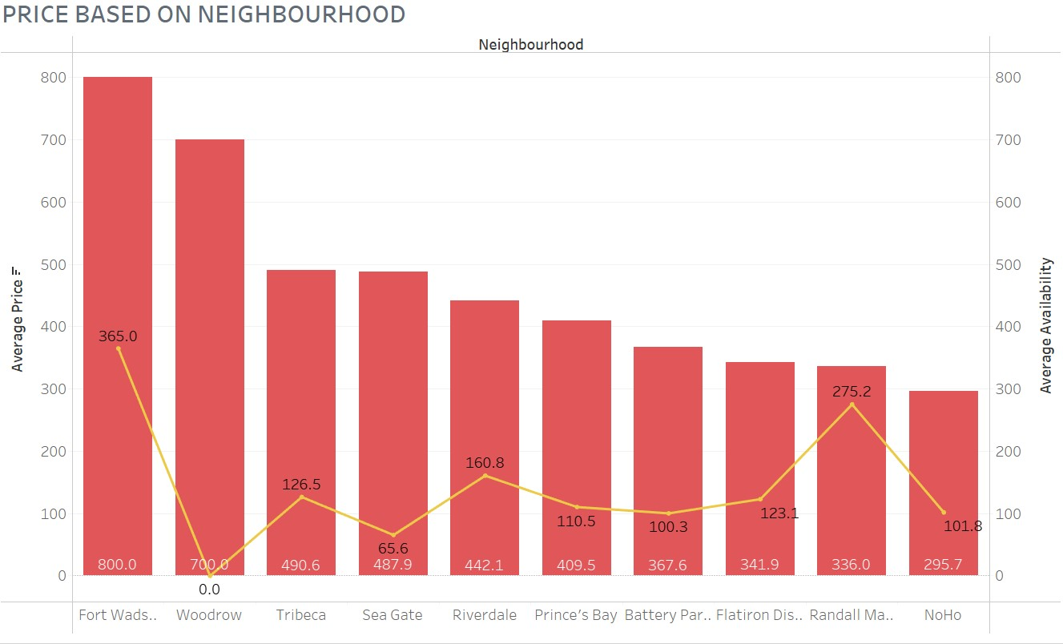
TOP NEIGHBOURHOOD AND AVAILABILITY
Among the neighbourhood, Williamsburg has highest bookings which stands at 3920 followed by Bedford-Stuyvesant with total bookings of 3714.
Fort Wadsworth has highest average price among the neighbourhood with 800 USD and is the only neighbourhood which has properties available 365 days an year.
Top 10 neighbourhood based on bookings has relatively lowest average availability of 107 days which is lower than the average of all neighbourhood i.e. 152 days.

Slide 10
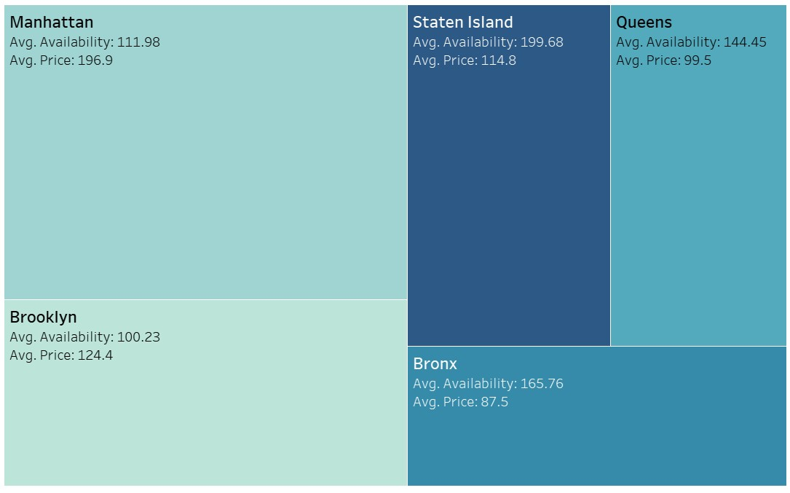
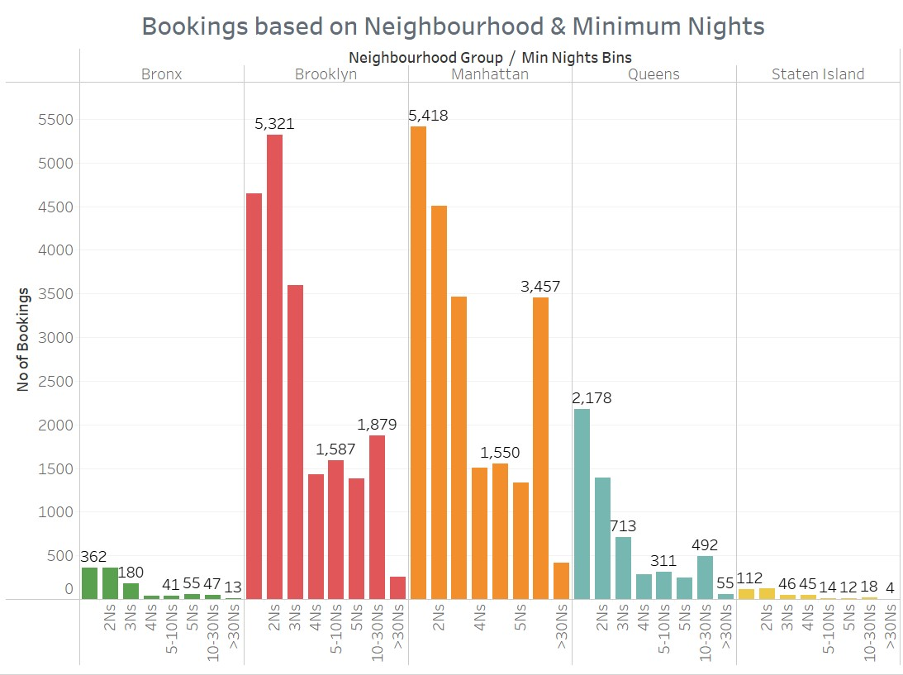
AVAILABILITY BASED ON NEIGHBOURHOOD GROUP
Though Manhattan has highest share of bookings among the other neighbourhood groups and highest average price (196.9 USD), availability is relatively lower which stands at 112 days.
Hence, availability of properties with minimum nights of 1 day and 2 days needed to be focused on the Brooklyn and Manhattan.
Listing with minimum night of 10 – 30 days has highest bookings of 3457 which could be a huge potential for revenue generation.

Slide 11
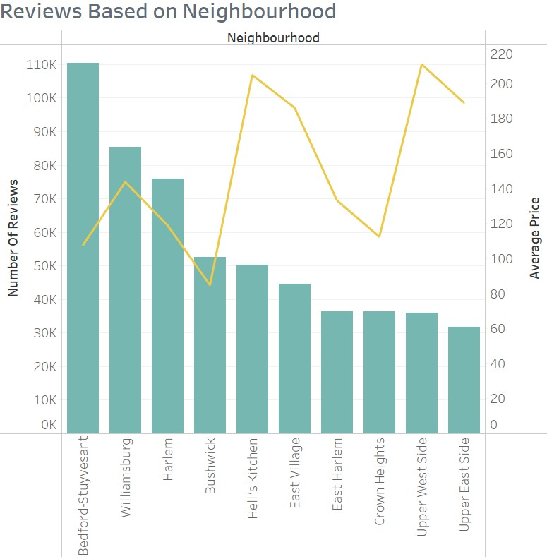
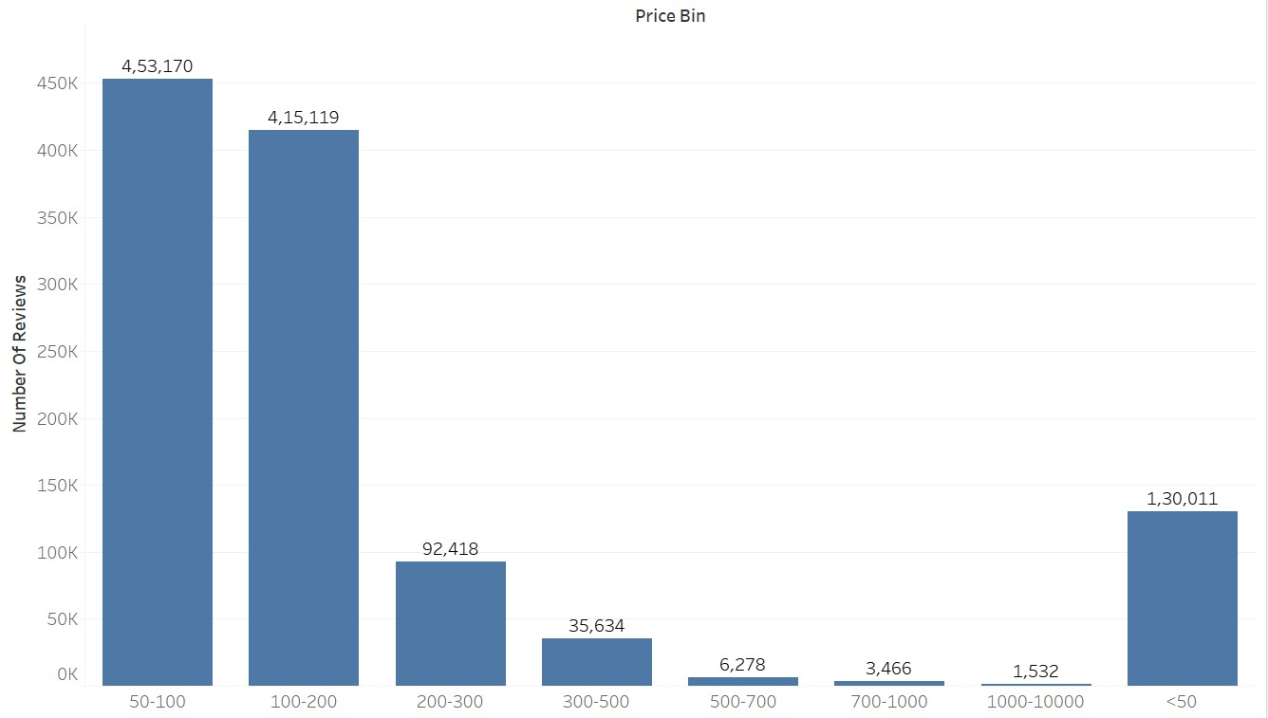
REVIEWS BASED ON NEIGHBOURHOOD
Among the neighbourhood, Bedford-Stuyvesant has received highest number of reviews which stands at 1,10,352.
Further, listings within the price range of 50 to 200 USD has received the highest number of reviews which accounts for 868289 reviews.
Bedford-Stuyvesant, having garnered the highest number of reviews, coupled with an average price of $107, signifies noteworthy popularity and warrants focused attention.

Slide 12
BUSINESS RECOMMENDATIONS
A significant trend has emerged among customers, with a clear preference for listings falling within the price range of $50 to $200, as evidenced by a substantial 33,950 bookings within this specific pricing bracket.
The emphasis should be directed towards the availability of properties offering minimum stay options of 1 and 2 days, particularly in the Brooklyn and Manhattan neighborhood groups.
The top 10 neighborhoods, based on bookings, exhibit a comparatively lower average availability of 107 days, which falls below the overall neighborhood average of 152 days. Consequently, there is a need to enhance the availability of properties in these top-performing neighborhoods.

